Slide 1
Collaborative multiagent reinforcement learning by payoff propagation
Literature review

Slide 2
Contents
1
Background
2
Methodology
3
Empirical study

Slide 3
1 Background
Motivation
Traditional single agent technique dose not work.
Action space scales exponentially with the number of agents
Independent multi agent technique dose not work.
The behavior of one agent influences the outcome of the individually selected actions of the other agents, therefore results in a dynamic environment and possibly compromises convergence
Different agents receive incomplete and noisy observations of the state space (Not consider in this paper)
Notes:
Markov decision processes are intended to include just these three aspects—sensation, action, and goal—in their simplest possible forms without trivializing any of them.

Slide 4
1 Background
Focus
Scenario: Collaborative multiagent systems in which the agents have to work together in order to optimize a shared performance measure.
Problem: Collaborative multiagent Markov decision process
Each agent selects an individual action in a particular state. Based on the resulting joint action the system transitions to a new state and the agents receive an individual reward.
Agents repeatedly interact with their environment and try to optimize the long-term reward they receive from the system, which depends on a sequence of joint decisions.
The global reward is the sum of all individual rewards.
Application scenarios: Model-free learning techniques in which the agents do not have access to the transition or reward model
Notes:
Markov decision processes are intended to include just these three aspects—sensation, action, and goal—in their simplest possible forms without trivializing any of them.

Slide 5
1 Background
Contribution
A ‘payoff propagation’ algorithm (max-plus) to find an approximately maximizing joint action for a coordination graph (CG) in which all local functions are specified beforehand .
Scalable to large groups of agents with many dependencies
Analysis on different decompositions of the global action-value function using CG
Notes:
Markov decision processes are intended to include just these three aspects—sensation, action, and goal—in their simplest possible forms without trivializing any of them.

Slide 6
2 Methodology
Coordination Graphs and Variable Elimination

Slide 7
2 Methodology
Coordination Graphs and Variable Elimination
1
2
4
3
5
8
6
7
A system of 8 agents

Slide 8








2 Methodology
Coordination Graphs and Variable Elimination
$$a_{1}$$
$$a_{2}$$
1
2
$$a_{4}$$
$$a_{3}$$
4
3
$$a_{5}$$
5
8
$$a_{8}$$
$$a_{6}$$
6
$$a_{7}$$
7
Each agent will act at decision step

Slide 9

2 Methodology
Coordination Graphs and Variable Elimination
$$a_{1}$$
$$a_{2}$$
1
2
Evaluation is based on all actions
$$a_{4}$$
$$u(a_{1},a_{2},a_{3},a_{4},a_{5},a_{6},a_{7},a_{8})$$
$$a_{3}$$
4
3
$$a_{5}$$
5
8
$$a_{8}$$
$$a_{6}$$
6
$$a_{7}$$
7
Each agent will act at decision step

Slide 10

2 Methodology
Coordination Graphs and Variable Elimination
$$a_{1}$$
$$a_{2}$$
1
2
Evaluation is based on all actions
$$a_{4}$$
$$u(a_{1},a_{2},a_{3},a_{4},a_{5},a_{6},a_{7},a_{8})$$
$$a_{3}$$
4
3
$$a_{5}$$
5
Size of joint actions grows exponentially and the optimization becomes intractable
8
$$a_{8}$$
$$a_{6}$$
6
$$a_{7}$$
7
Each agent will act at decision step

Slide 11
2 Methodology
Coordination Graphs and Variable Elimination
$$a_{1}$$
$$a_{2}$$
1
2
$$a_{4}$$
$$a_{3}$$
4
3
$$a_{5}$$
5
8
$$a_{8}$$
$$a_{6}$$
6
$$a_{7}$$
7
Action of each agent $i$ depends only on subset of other agents $j∈Γ(i)$

Slide 12


2 Methodology
Coordination Graphs and Variable Elimination
$$a_{1}$$
$$a_{2}$$
$$u(a_{1},a_{2},a_{3},a_{4},a_{5},a_{6},a_{7},a_{8})$$
1
2
Global payoff function is decomposed into a linear combination of local payoff functions
$$a_{4}$$
$$a_{3}$$
4
3
$$a_{5}$$
$$u\left(a\right)=\sum_{i=1}^{8}{f_{i}(a_{i})}$$
5
8
$$a_{8}$$
$$a_{6}$$
6
$$a_{7}$$
$$a_{i}=\{a_{i},a_{j}|j∈Γ(i)\}$$
7
Action of each agent $i$ depends only on subset of other agents $j∈Γ(i)$

Slide 13








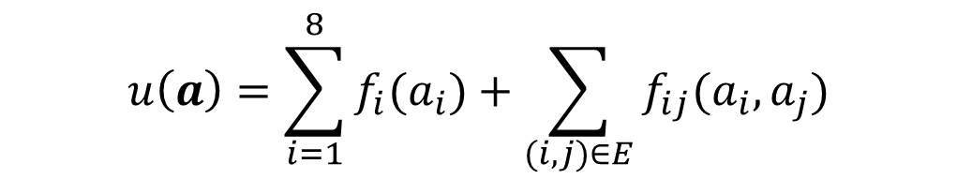














2 Methodology
Coordination Graphs and Variable Elimination
$$u\left(a\right)=\sum_{i=1}^{8}{f_{i}(a_{i})}$$
$$f_{2}$$
$$f_{1}$$
$$a_{i}=\{a_{i},a_{j}|j∈Γ(i)\}$$
$$f_{12}$$
1
2
$$f_{24}$$
$$f_{13}$$
$$f_{4}$$
$$f_{15}$$
Coordination on an undirected graph structure
payoff functions are defined over at most two agents
$$f_{3}$$
4
$$f_{45}$$
3
$$f_{5}$$
5
$$f_{58}$$
$$f_{38}$$
$$f_{46}$$
$$f_{56}$$
$$u\left(a\right)=\sum_{i=1}^{8}{f_{i}(a_{i})}+\sum_{(i,j)∈E}{f_{ij}(a_{i},a_{j})}$$
$$f_{57}$$
8
$$f_{8}$$
$$f_{78}$$
6
$$f_{67}$$
$$f_{7}$$
$$f_{6}$$
7
Action of each agent $i$ depends only on subset of other agents $j∈Γ(i)$

Slide 14
2 Methodology
Coordination Graphs and Variable Elimination
$$u\left(a\right)=\sum_{i=1}^{8}{f_{i}(a_{i})}$$
$$f_{2}$$
$$f_{1}$$
$$a_{i}=\{a_{i},a_{j}|j∈Γ(i)\}$$
$$f_{12}$$
1
2
$$f_{24}$$
$$f_{13}$$
$$f_{4}$$
$$f_{15}$$
Coordination on an undirected graph structure
payoff functions are defined over at most two agents
$$f_{3}$$
4
$$f_{45}$$
3
$$f_{5}$$
5
$$f_{58}$$
$$f_{38}$$
Limitation： Predefined coordination structure
$$f_{46}$$
$$f_{56}$$
$$u\left(a\right)=\sum_{i=1}^{8}{f_{i}(a_{i})}+\sum_{(i,j)∈E}{f_{ij}(a_{i},a_{j})}$$
$$f_{57}$$
8
$$f_{8}$$
$$f_{78}$$
6
$$f_{67}$$
$$f_{7}$$
$$f_{6}$$
7
Action of each agent $i$ depends only on subset of other agents $j∈Γ(i)$

Slide 15
2 Methodology
Coordination Graphs and Variable Elimination
$$f_{2}$$
$$f_{1}$$
$$f_{12}$$
1
2
$$f_{24}$$
$$f_{13}$$
$$f_{4}$$
$$f_{15}$$
$$f_{3}$$
4
$$f_{45}$$
3
$$f_{5}$$
5
$$f_{58}$$
$$f_{38}$$
$$f_{46}$$
$$f_{56}$$
$$f_{57}$$
8
$$f_{8}$$
$$f_{78}$$
6
$$f_{67}$$
$$f_{7}$$
$$f_{6}$$
7

Slide 16
2 Methodology
Payoff Propagation and the Max-Plus
The Max-Plus Algorithm
Experiments

Slide 17
2 Methodology
Collaborative Multiagent Reinforcement Learning
Collaborative Multiagent MDP and Q-Learning
MDP Learners
Independent Learners
Coordinated Reinforcement Learning
Distributed Value Functions

Slide 18
2 Methodology
Sparse Cooperative Q-Learning
Agent-Based Decomposition
Edge-Based Decomposition
Edge-Based Update
Agent-Based Update

Slide 19
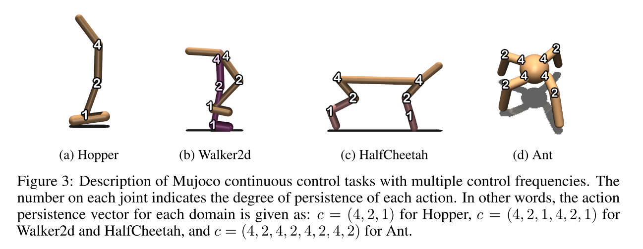
3 Experiments

Slide 20
Thank you !

